Slide 1
Agenda Highlevel flow
Migration + SAP, IDW
Intro
Journey Thus far
If you find this useful,
How should you migrate, Key consideration
It is not always migrating SAP + Databricks Partnership
What is available right now in Databricks
NCS to explain the value of SAP + Databricks.

Slide 2

Migration + SAP
Data Intelligence Webinar Series

Slide 3


Today’s Speaker
Data Intelligence Webinar Series
Jee Khen (JK) Wong
Senior Partner Solution Architect, APJ
Jee Khen (JK) Wong
Senior Partner Solution Architect, APJ

Slide 4
Intelligent Data Warehousing: To Migrate or to Interoperate
Data Intelligence Webinar Series

Slide 5
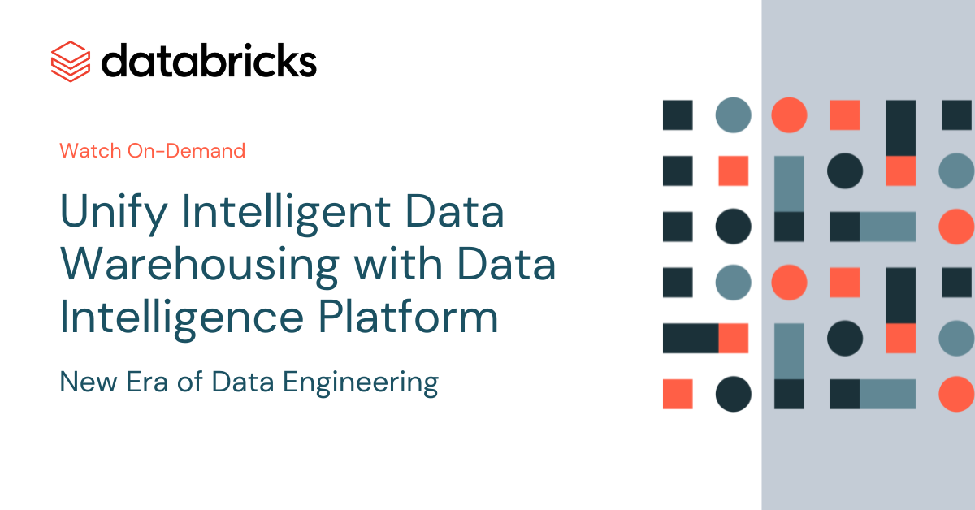
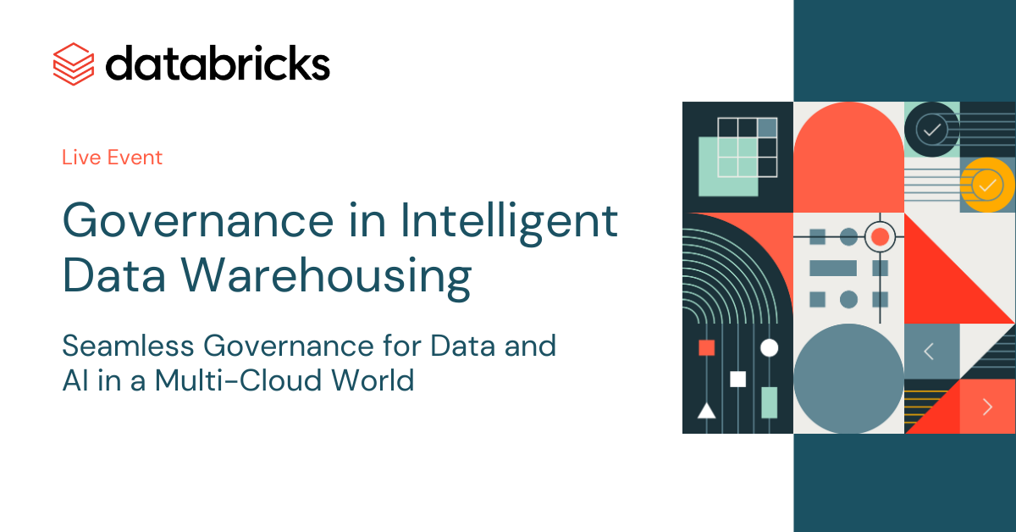
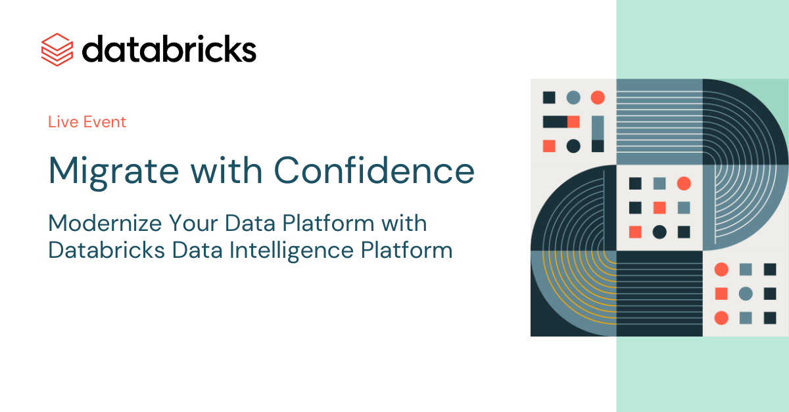
Journey till date……
Data Intelligent Webinar Series
Intelligence Data Warehousing (On-Demand)
Governance
(On-Demand)
More to Come!!!!
Migration or Integration (Live)

Slide 6








Databricks Data Intelligence Platform
100% serverless
Disaster recovery
Cost controls
Enterprise security
Databricks SQL
Data warehousing
Workflows/DLT
Ingest, ETL, streaming
Mosaic AI
Artificial intelligence
AI/BI
Business intelligence
Lakehouse
Notes:
On top of this open lakehouse foundation, you’re able to execute all of your data and AI initiatives
Mosaic AI provides end-to-end AI for both generative and classical AI
Notebooks offer a deep set of data science capabilities
Databricks SQL offers the most performant data warehouse in the cloud
AI/BI integrates deeply with Databricks SQL to easily extend business intelligence across the business
And LakeFlow ensures that you can reliably ingest and transform all of the data these workloads require

Slide 7
Complete DW capabilities
Lowering migration cost
Serverless warehouses
Views/temp views
ANSI SQL
Data quality monitoring
Can monitor permissions
1P/3P connectors
SQL scripting
SQL UDFs
Table ACLs
Billing system tables
CDC support
H3 GeoSpatial
Session Vars
Lakehouse Federation
Internet on/off
Streaming tables
Spatial SQL (ST_)
SQL alerts
HMS Federation
Queries system table
Materialized views
Foreign/primary keys
Dashboards
Table lineage
Warehouses Sys table
Autoloader for ingest
Lateral Col Alias
Dashboard sharing
Entity relation diagram
WH Events Sys table
Scheduled workflows
Named arguments
Publish to PowerBI
Row/Col Security
Query duration limits
1p/3p orchestration
HyperLogLog
Publish to Tableau
OAuth
Foreign/primary keys
SQL editor
Array functions
Cloud Fetch
ABAC
Query history
Python/Go connectors
Identifier clause
Python UDFs
Marketplace
Query profiling
SQL Rest API
Variant data type
Row level concurrency
100K+ user support
Warehouse monitoring
Foundational functionality
Governance and administration
©2024 Databricks Inc. — All rights reserved
Notes:
We understand that in order to support data warehousing worklaods, we’d need to have a lot of the tablestake features.
You can’t have a data warehouse without materialized views or role-based access controls. So we built all those into various foundational components of the lakehouse, including Delta and Unity, and expose through DBSQL.

Slide 8
Migration Approaches

Slide 9
Choices during EDW Modernization?
Option 1:
Lift and Shift to yet another Cloud Data Warehouse?
Option 2:
Modernize your architecture on Open Lakehouse
Notes:
Ask yourselves - what value will you get out of just replicating your current architecture in the cloud to yet another Data Warehouse?
as it will invariably run into Volume, Variety and Velocity issues and be eventually cost prohibitive.
Or should you take this opportunity to modernize?
(Avoid the mistakes of the past - future proof your Data Architecture.)
Soham Bhatt:
So once you decide to move on the cloud, One option is you just replicate your architecture in the cloud or take this opportunity to use Best of the breed Lakehouse architecture.

Slide 10
Migration Approaches
Option 1 : Lift & Shift
Option 2 : Modernize - Use case based (Databricks Recommended)
Advantage:
Less Mandays on Contract
Faster end-to-end project (May not be true if you include debugging time)
Disadvantage:
Customer do not see short term result within 6 months - 1 year
Bring existing problem from EDW directly to Databricks (Perf and Data Issues)
Hard to debug issues (Not following Databricks Best Practices)
Higher chance of project delays (Alot of unforeseen issues)
Advantage:
Each use cases produce visible milestones to customer
Identify issue early at first use case, subsequent use cases are more manageable (Agile Approach)
Debugging are more straightforward (Only Databricks related)
More accurate and easier to adhere to project timeline
Customer are usually more happy throughout the entire project
Disadvantage:
Project duration seems longer (only on paper)

Slide 11





Methodology
Phase 1 Discovery
Phase 2
Assessment
Phase 3
Strategy
Phase 4
TurnKey Delivery Proposal
Phase 5
Execution
Migration specific discovery and consultation
Assessment, Design, Tooling, Accelerators, Sizing, Partners
Technology mapping, migration workshop, migration planning
Reference implementation of a production use case, Overall migration implementation plan
Migration execution and support
Databricks Migration Team with/without Partner
Databricks PS Driven
Partner Driven

Slide 12



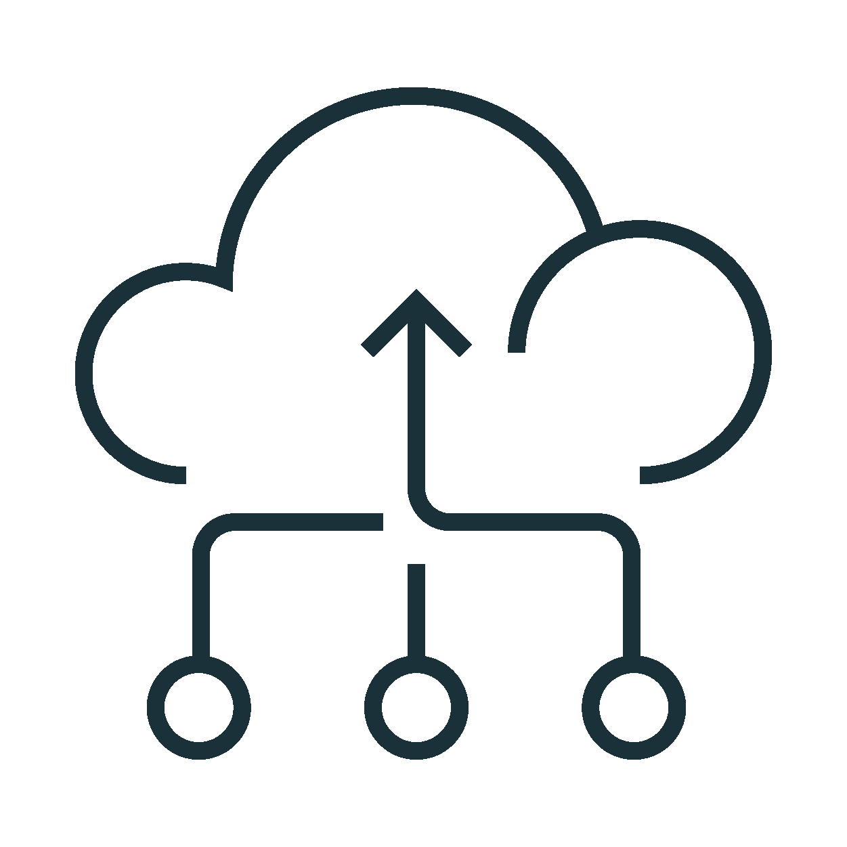


Technical Migration Approach
Architecture/ Infrastructure
Establish deployment Architecture
Implement Security and Governance framework
Data Migration
Map Data Structures and Layout
Complete One time load
Implement incremental load approach
ETL and Pipelines
Migrate Data transformation and pipeline code, orchestration and jobs
Speedup your migration using Automation tools
Validate: Compare your results with On Prem data and expected results
BI and Analytics
Re-point reports and analytics for Business Analysts and Business Outcomes
OLAP cube repointing
Connect to reporting and analytics applications
Data Science/ML
Establish connectivity to ML Tools
Onboard Data Science teams

Slide 13
Rip and Replace?

Slide 14

SAP x Databricks
Partnership Announcement

Slide 15
NCS Slides

Slide 16
SAP is a goldmine for Data & AI
SAP systems have the most business critical data
56% of executives plan to move budget to SAP-specific gen AI¹
AI initiatives continue to be top of mind
Cloud architectures accelerate SAP-specific AI adoption
44% executives report positive results from gen AI in the cloud¹
By 2026, over 80% of enterprises will be using GenAI in production environments, up from less than 5% in 2023
2023 Gartner Hype Cycle for Generative AI
Solid foundation for training AI models
Grounding AI training in semantically rich SAP data from finance, HR, supply chain, and more generates great results

Slide 17









Key use cases unlocked with SAP data
SAP systems form the backbone of enterprises globally
Revenue, Cashflow & Profit Forecasting
ENTERPRISE PLANNING
PRODUCTION & OPERATIONS
Supply Chain Optimization
FINANCIAL MANAGEMENT
SUPPLY CHAIN
Demand Planning & Forecasting
CORE BUS OPS
Inventory Management
HUMAN RESOURCES
INVENTORY
MANAGEMENT
Production Optimization
SERVICE & SUPPORT
SALES & MARKETING
Asset Optimization & Predictive Maintenance
Notes:
SAP systems are the backbone of global commerce, powering an astounding 84% of total global trade. The pervasive use of SAP across industries and its significant impact on business performance shows why SAP data is considered the most valuable data for enterprises globally.
Source:
https://www.wbresearch.com/events-logichem-us-august-2020/sponsors/sap-2024#:~:text=SAP%20is%20the%20market%20leader,revenue%20touches%20an%20SAP%20system.
https://www.sap.com/documents/2017/04/4666ecdd-b67c-0010-82c7-eda71af511fa.html

Slide 18
But majority of SAP data remains untapped for AI

Slide 19


It’s been hard to make this a reality
HIGH COST
Extracting data is difficult, time-consuming, and slow
QUALITY CONCERNS
Current solutions inconsistently retain SAP context
MISSED INNOVATION
Production-quality AI applications are hard to achieve
NATIVE ACCESSIBILITY
Combine SAP and external data without expensive workarounds
HIGH TRUST
Maintain trust that data is accurate and protected
DOMAIN-SPECIFIC AI
Build AI applications that understand your SAP and external data
Notes:
Customers are looking for efficient ways to make SAP data available for business analytics and intelligence AI applications to enable connected insights across business processes. However, accessing SAP data in real-time and integrating it with other sources is complex due to siloed systems and diverse formats. Organizations need to build expensive ETL pipelines and ingestion capabilities to get timely access to harmonized SAP data. This creates data duplication and inefficiencies between systems, slowing down decision making. Next, organizations struggle to maintain trust in the data they bring from SAP and external systems due to data quality issues. Finally, they struggle to integrate their SAP data with modern cloud based AI and analytics platforms for data-driven insights.

Slide 20
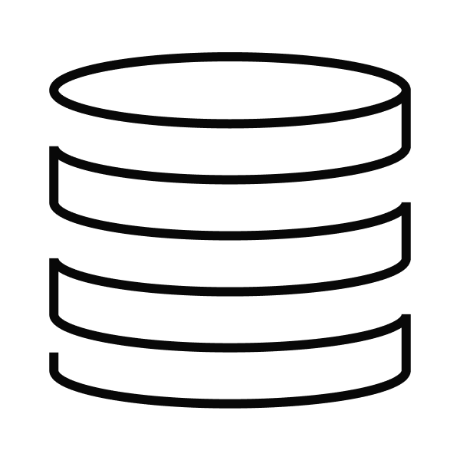













Power your SAP data with AI
Data Warehousing
Databricks SQL
Data Engineering
LakeFlow
SAP Business Data Cloud Frictionless AI and analytics on your SAP data products
SAP Insight Apps
AI and Data Science
Mosaic AI
SAP Analytics Cloud
Data Warehousing
Databricks SQL
Data Governance
Unity Catalog
SAP Datasphere
SAP BW[/4]HANA on RISE
Curated, Context-rich SAP Data Products
SAP Applications
S/4HANA RISE Private Cloud, Successfactors, Ariba, etc.
Other Platforms
Multi-cloud Flexibility

Slide 21
Partner Additional Slides

Slide 22
Summary
Notes:
Next, let’s look at how Databricks SQL uses predictive optimizations to automatically tune the system

Slide 23
Databricks Data Intelligence Platform
100% serverless
Disaster recovery
Cost controls
Enterprise security
Databricks SQL
Data warehousing
Workflows/DLT
Ingest, ETL, streaming
Mosaic AI
Artificial intelligence
AI/BI
Business intelligence
Lakehouse
Notes:
On top of this open lakehouse foundation, you’re able to execute all of your data and AI initiatives
Mosaic AI provides end-to-end AI for both generative and classical AI
Notebooks offer a deep set of data science capabilities
Databricks SQL offers the most performant data warehouse in the cloud
AI/BI integrates deeply with Databricks SQL to easily extend business intelligence across the business
And LakeFlow ensures that you can reliably ingest and transform all of the data these workloads require

Slide 24
Next Steps

Slide 25

What’s Next?
Discover more at our upcoming events
Register Now!

Slide 26
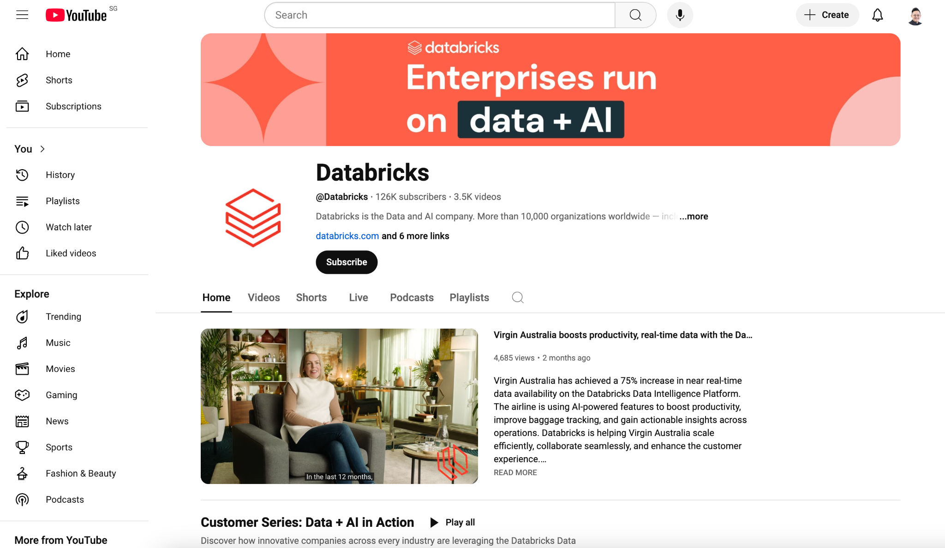
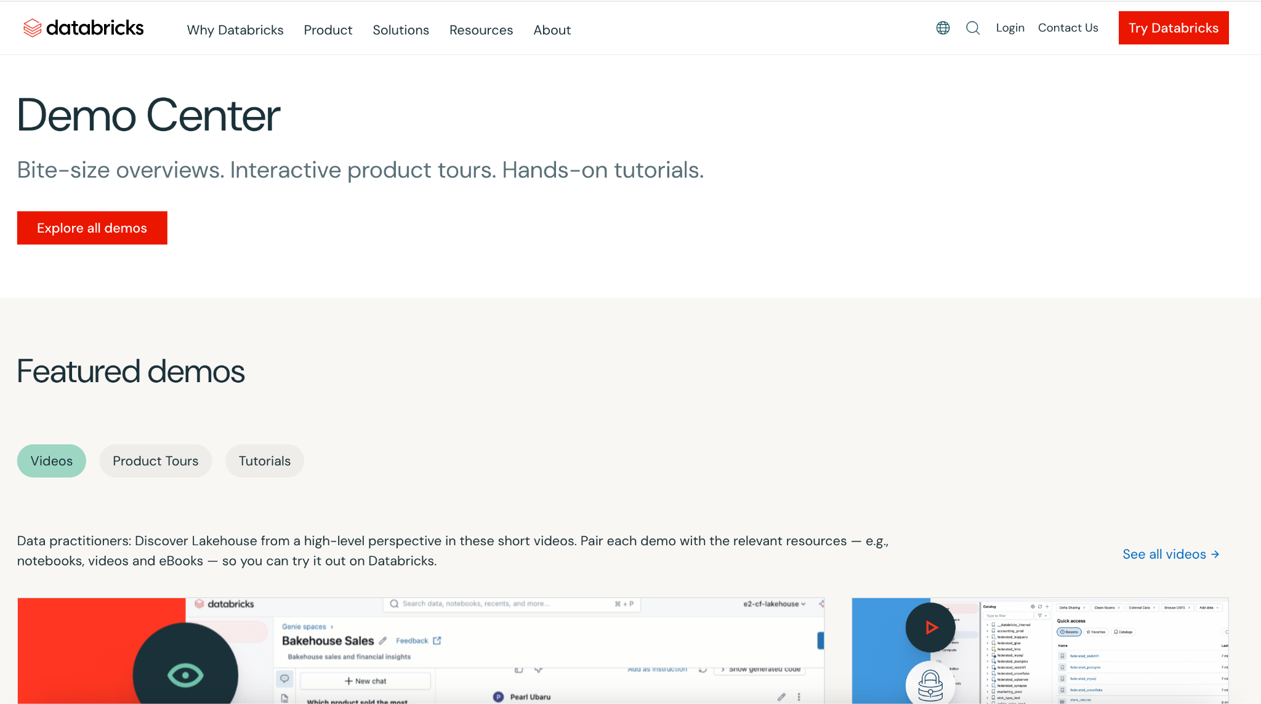
What’s Next?
Demos and Videos
Databricks Youtube Channel
https://www.youtube.com/c/databricks
Databricks Demo Center
https://www.databricks.com/resources/demos

Slide 27

Share Your Feedback
Let us know how we can help shape your organization’s data and AI journey.

Slide 28

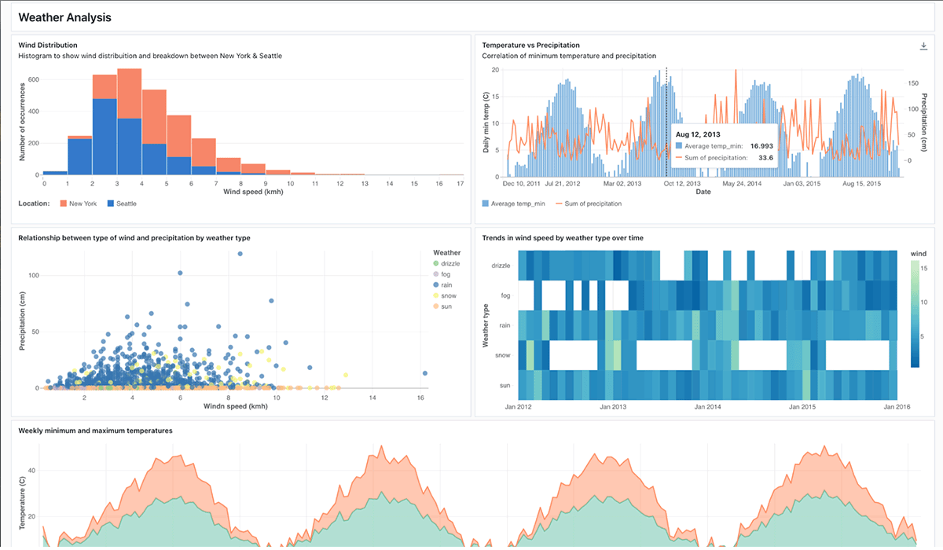
Databricks SQL
Get started with intelligent data warehousing!
Try for free
www.databricks.com/try
$400 free serverless credits
Learn more: databricks.com/product/databricks-sql

